Slide 1

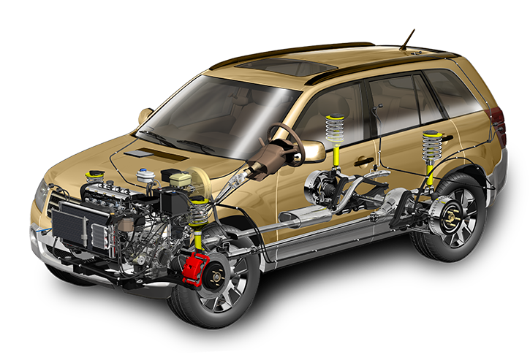
Docker Engine
Analogy between the car engine and the Docker engine
The car needs an engine to run, similarly Docker needs an engine to run.
Docker Engine sits on top of the host operating system
Introduction

Slide 2
Docker Engine
In short Docker engine, is a lightweight container run time. Let us go through what it means….
Container 1
JDK 1.7
Tomcat 7
Container 2
JDK 1.8
Tomcat 8
It is a container run time which allows you to run multiple containers.
As an example, imagine running multiple JDKs and Tomcat servers on the same OS.
Host Operating System (Windows, MAC OSX, Linux)
Docker Engine
Infrastructure - Server
Introduction

